Slide 1
Model-
Based
Reinforcement
Learning
Last lecture : learn policy directly from experience
→Policy based method
Previous lectures : learn value function directly from experience
→Value function based method
This lectures : learn model directly from experience
And use Planning to construct a value function or policy

Slide 2
Model-Based
And
Model-Free
Model-Free RL
# No model
# Learn value function (and/or policy) from experience
→ The agent doesn’t make any effort to explicitly represent the transition dynamics
Model-Based RL
# Learn a model from experience
# Plan value function (and/or policy) from model
→ Learns a model from experience.
→ Look ahead to think to compute to figure out what right value function or action are select in this environment.

Slide 3
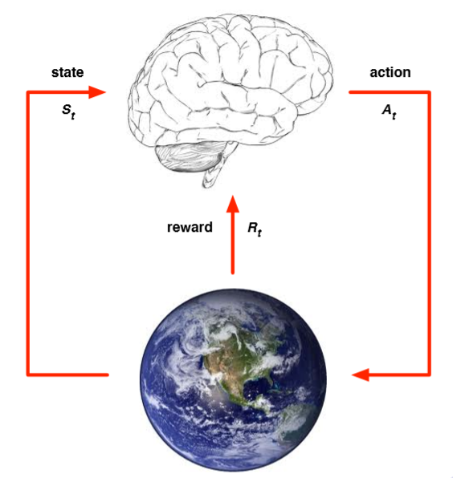
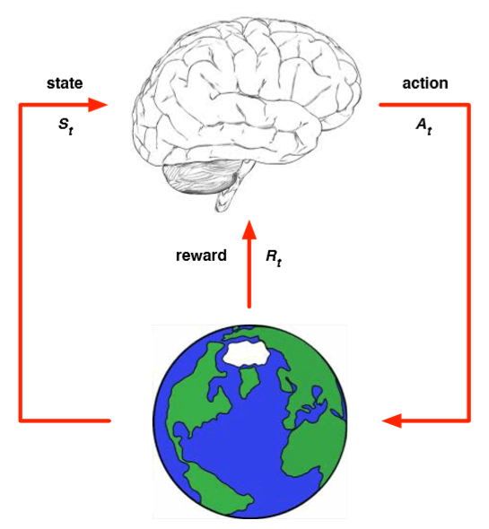
Model-Based
And
Model-Free
Model-Free RL
Model-Based RL
Real World(environment)
Imagined World(environment)

Slide 4
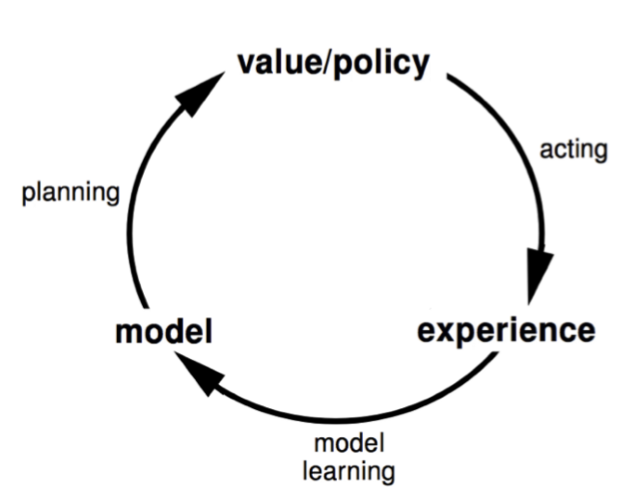
Model-Based
RL
Based reinforcement learning we can kind of define it by this cycle.
Then you used to act in the real world
Start to have interactions with that model and the interactions with model generate value/policy
This is like a look ahead process.
The agents actual experience this is it really interaction with real world(not imagine)
Build up model
How that env acts
The env does every time

Slide 5
Advantages of Model-Based RL
Advantages:
# Can efficiently learn model by supervised learning methods
→ Able to lookahead its able to estimate the value function.
# Can reason about model uncertainty
Disadvantages:
# First learn a model, then construct a value function.
→ Two sources of approximation error.

Slide 6
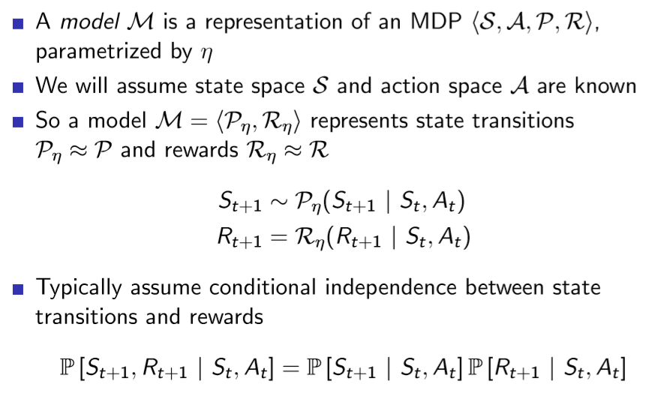
What is a Model?

Slide 7
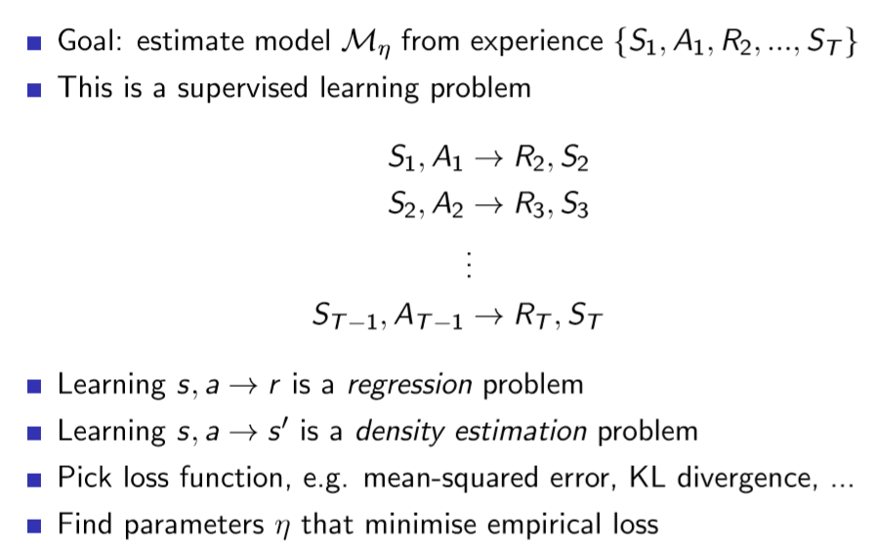
Model Learning

